Slide 1
App widgets
Advanced Android Development
Lesson 2

Slide 2

2.1 App widgets
Create miniature app views for home screen

Slide 3
Contents
Overview of app widgets
Adding an app widget to an app
Updating the provider-info file
Defining the app widget layout
Creating the app widget-provider class
App widget updates and actions
Using a configuration activity

Slide 4
Overview
App widgets

Slide 5
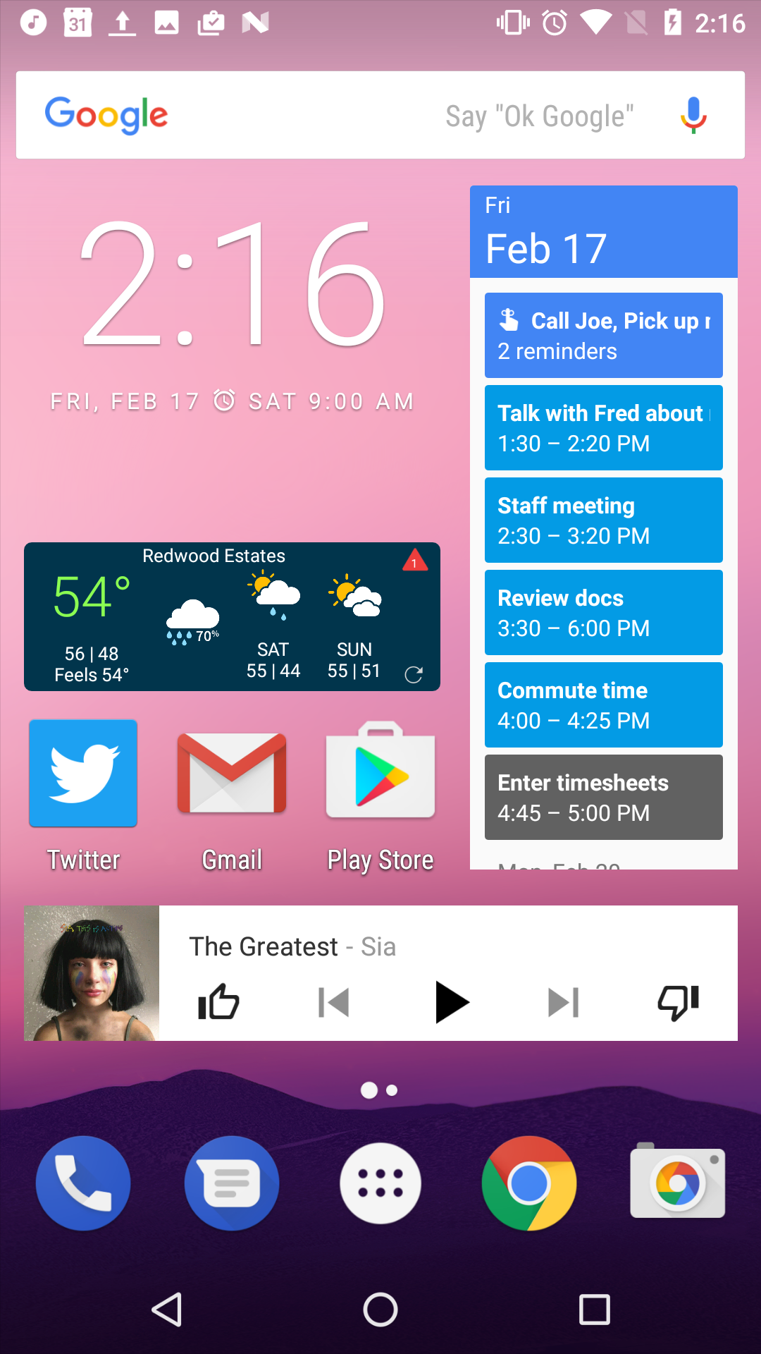
What are app widgets?
Miniature app views for apps
Appear on home screen
Updated with new data even if apps are not running

Slide 6
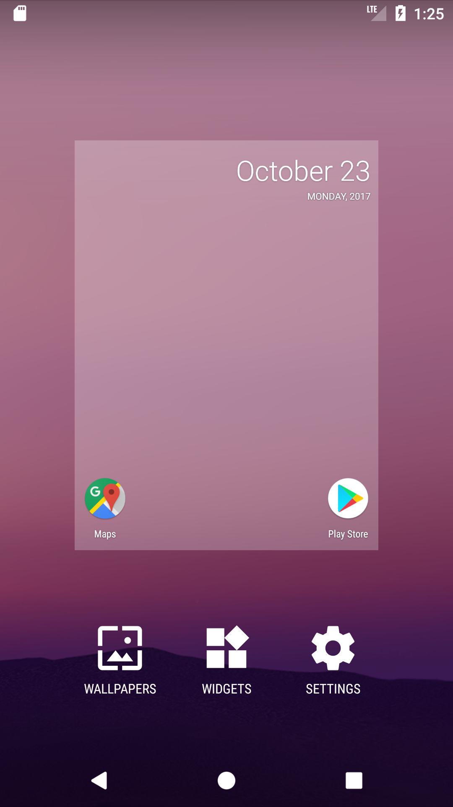
How to install widgets
When user installs app, associated app widgets appear in widget picker
User long-presses home screen and taps Widgets
Widget picker appears with list
User selects app widget to place on home screen

Slide 7
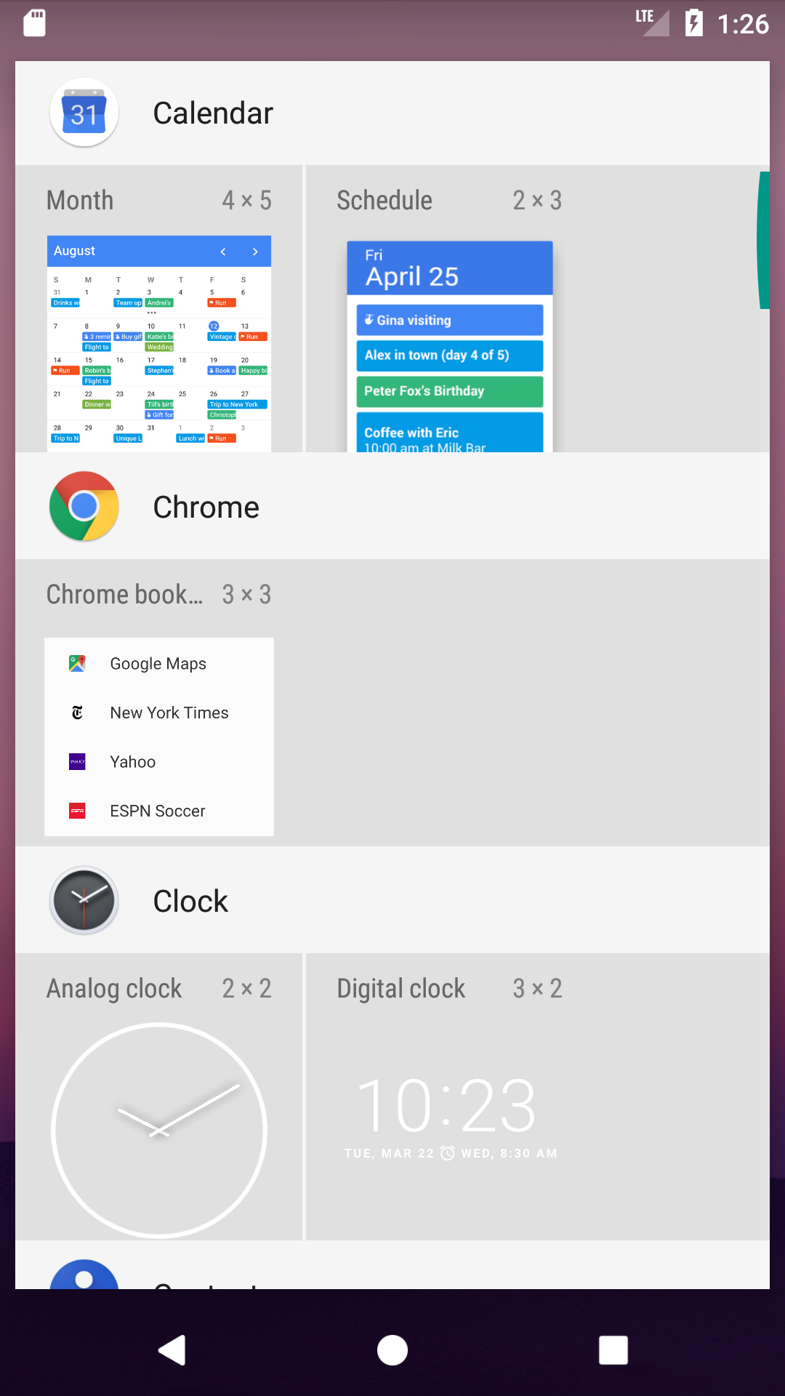
What can app widgets do?
Display info
Perform simple functions such as
Showing the time
Summarizing calendar events
Controlling music playback
Provide a scrolling list or collection
Open associated app when tapped

Slide 8
App widget components
Provider-info XML file defines metadata
Layout XML file for UI
AppWidgetProvider for Java code
Configuration activity (optional)
Choose what to display
See Android News & Weather widget for example

Slide 9
Provider-info XML metadata
Initial or minimum size
Update interval
Configuration activity (if any)
Preview image

Slide 10
Example: Provider-info XML file
<appwidget-provider xmlns:android="http://schemas.android.com/apk/res/android"
android:initialKeyguardLayout="@layout/new_app_widget"
android:initialLayout="@layout/new_app_widget"
android:minHeight="180dp"
android:minWidth="110dp"
android:previewImage="@drawable/example_appwidget_preview"
android:resizeMode="horizontal|vertical"
android:updatePeriodMillis="1800000"
android:widgetCategory="home_screen">
</appwidget-provider>

Slide 11
App widget-provider class
App widgets are broadcast receivers
Extend AppWidgetProvider, which extends BroadcastReceiver
AppWidgetProvider objects receive only broadcasts relevant to app widget
Including intents for update, enabled, disabled, and deleted
App widget providers are declared in Android manifest

Slide 12
App widget manager and host
App widget controlled by manager and host
AppWidgetManager
Manages widget content updates
Sends broadcast intents
AppWidgetHost holds and displays app widgets
Home screen is most frequent host
Also possible to create your own host

Slide 13
Update the app widget
Update interval is defined in provider-info file
Must be at least 30 minutes to avoid performance issues
App can request app widget update explicitly
App widget manager sends broadcast intent with ACTION_APPWIDGET_UPDATE
Widget-provider class receives intent and calls onUpdate()
Implement onUpdate() in widget-provider class

Slide 14
App widget updates and battery life
Updates occur whether or not app is running
App widgets can wake sleeping device to do update
Enabling very frequent updates is bad design
Best practice is to design app widgets so they do not need frequent updates

Slide 15
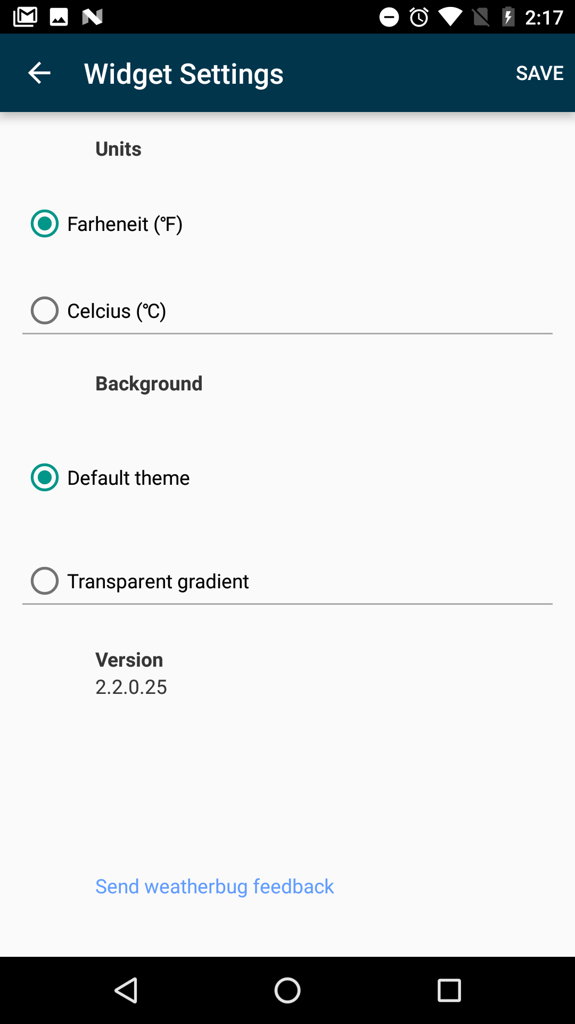
Configurable app widgets
Some widgets need to be configured by user
Photo widget needs user to pick photo
Stock-ticker widget needs list of stock symbols
Configuration activity appears when user first adds app widget
User can use multiple copies of same app widget with different configurations

Slide 16
Adding an app widget to an app

Slide 17
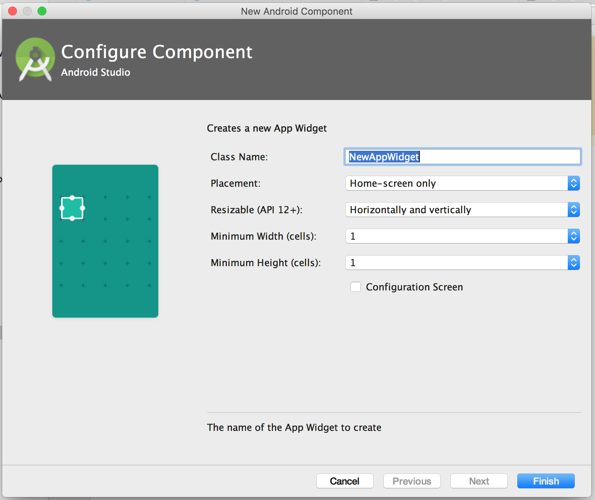
Add app widget in Android Studio (1)
Select File > New > Widget > App Widget
Class name must include the word Widget
Placement: Home-screen only

Slide 18
Add app widget in Android Studio (2)
Minimum width and height
Configuration Screen option to include configuration activity

Slide 19
Project files related to app widgets
Android Studio adds or modifies the following files:
Provider class NewAppWidget.java (extends AppWidgetProvider)
Layout file in res/layouts/new_app_widget.xml
Provider-info file in res/xml/new_app_widget_info.xml
Configuration Screen option adds NewAppWidgetConfigurationActivity.java
Android manifest is updated to include provider and configuration activity classes

Slide 20
Updating the provider info
Updating the app widget provider-info file

Slide 21
App widget provider-info file
App widget info XML file contains a single <appwidget-provider> element with these attributes:
minHeight | previewImage
minWidth | resizeMode
initialLayout | widgetCategory
updatePeriodMillis | configure

Slide 22
Example app widget provider info (1)
<appwidget-provider
xmlns:android="http://schemas.android.com/apk/res/android"
android:minHeight="40dp"
android:minWidth="40dp"
android:initialLayout="@layout/new_app_widget"
android:updatePeriodMillis="86400000"
android:previewImage="@drawable/new_appwidget_preview"

Slide 23
Example app widget provider info (2)
android:resizeMode="horizontal|vertical"
android:widgetCategory="home_screen"
android:configure=
"Com.example.android.widgettest
.MyAppWidgetConfigureActivity">
</appwidget-provider>
See AppWidgetProviderInfo for more information

Slide 24
Minimum initial size
Home screen provides grid cells (varies by device)
App widget stretches both horizontally and vertically to occupy grid cells based on android:resizeMode attribute
Rule for how many dp fit into a grid cell:
70 × grid_size − 30
grid_size is the number of cells for the widget

Slide 25
Minimum initial size table
# of columns or rows | minWidth or minHeight
1 | 40 dp
2 | 110 dp
3 | 180 dp
4 | 250 dp

Slide 26
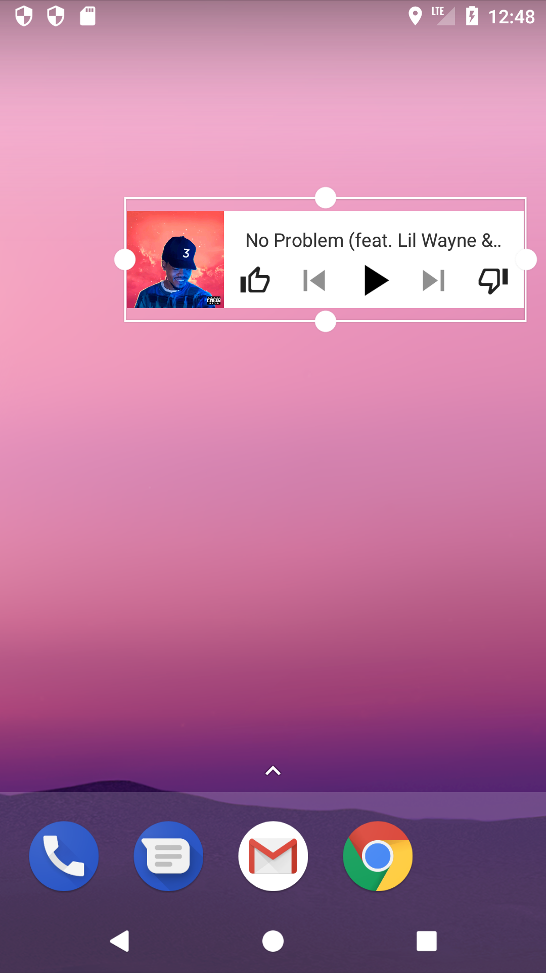
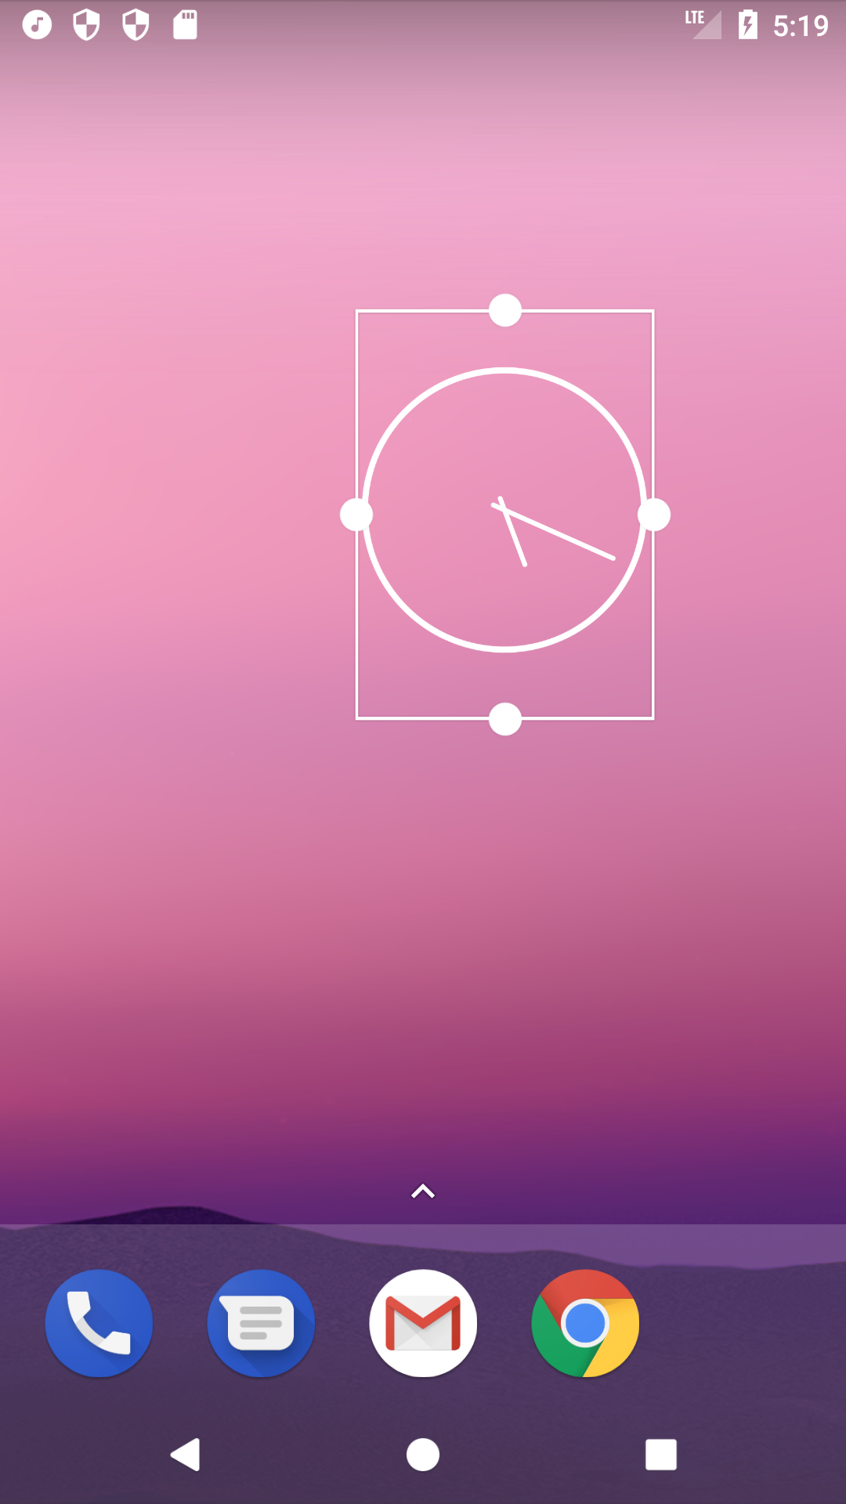
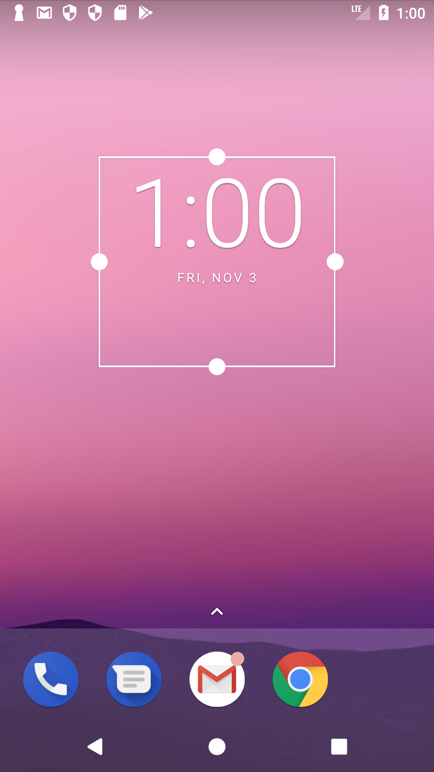
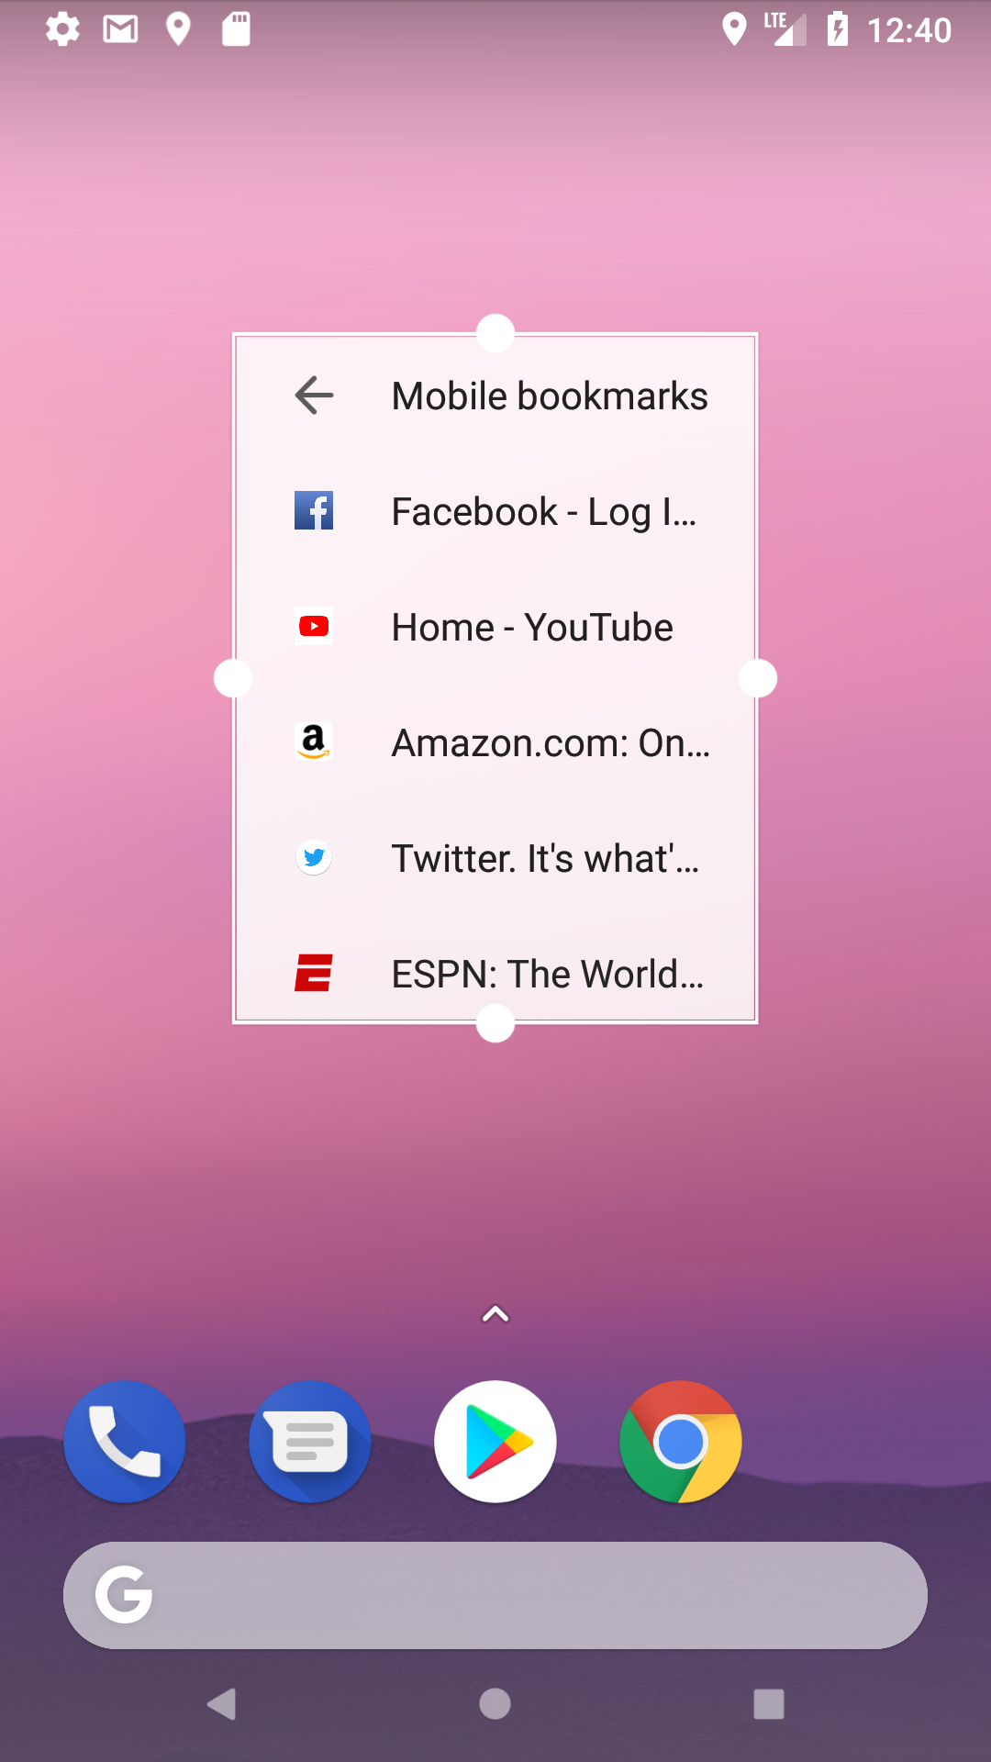
Widget examples
4X1 2X2 3X2 3X3

Slide 27
Defining the app widget layout
Defining the XML layout for the app widget UI

Slide 28
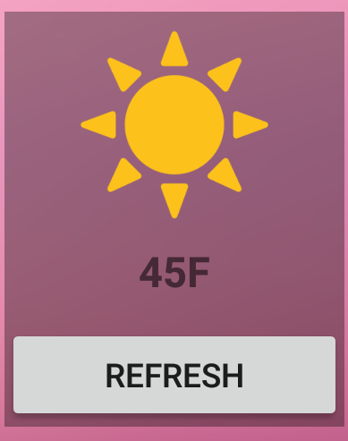
Design the app widget layout
Keep small and display limited info
See Widgets and App Widget Design Guidelines
Example: Layout for 1x2 weather widget shows ImageView, TextView, and Button inside a LinearLayout

Slide 29
App widget margins
App widgets need extra space around edges—API 14 and newer adds space for you
Android Studio creates resources for pre-14 and newer versions
widget_margin defined in default dimens.xml and new dimens.xml (v14) files
android:padding attribute added:
android:padding="@dimen/widget_margin"

Slide 30
Remote views
App widget layouts are based on RemoteViews
View hierarchy displayed in different process than app but with same permissions
Supports only subset of layouts and views (no custom views)

Slide 31
App widget updates app
Each time app widget updates your app it does the following:
Creates a RemoteViews object from the layout
Updates the views in the layout with data
Passes remote view to app widget manager to display

Slide 32
Layouts supported by RemoteViews
FrameLayout
LinearLayout
RelativeLayout
GridLayout

Slide 33
Views supported by RemoteViews
TextView, ListView
Button, ImageButton, ImageView
AnalogClock, Chronometer, ProgressBar
ViewFlipper, GridView, StackView, AdapterViewFlipper
ViewStub—invisible, zero-sized View to lazily inflate layout resources at runtime

Slide 34
Creating the provider
Implementing the app widget-provider class

Slide 35
Create app widget-provider class
Extend AppWidgetProvider
Override onUpdate() to construct layout and manage updates
Optional: Implement additional widget actions
Declare app widget provider as broadcast receiver in AndroidManifest.xml

Slide 36
Sample app widget-provider class
Android Studio template code supports multiple app widgets
public class NewAppWidget extends AppWidgetProvider {
@Override
public void onUpdate(Context context,
AppWidgetManager appWidgetManager, int[] appWidgetIds) {
for (int appWidgetId : appWidgetIds) {
// Update the app widget
}
}
}

Slide 37
Other app widget-provider methods
onDeleted(): Called when app widget instances are deleted
onEnabled(): Called when app widget is instantiated
onDisabled(): Called when last app widget instance is deleted
See AppWidgetProvider for details

Slide 38
Declare provider in Android manifest
Android Studio adds <receiver> element
<receiver android:name="NewAppWidgetProvider" >
<intent-filter>
<action android:name="android.appwidget.action.APPWIDGET_UPDATE" />
</intent-filter>
<meta-data android:name="android.appwidget.provider"
android:resource="@xml/example_appwidget_info" />
</receiver>

Slide 39
Key parts of Android manifest entry
name in <receiver> is class name for widget provider
<intent-filter> declares APPWIDGET_UPDATE to receive broadcast intents from app widget manager
<meta-data> specifies location of widget provider-info file

Slide 40
App widget updates and actions
Using onUpdate() and attaching actions with pending intents

Slide 41
Implement app widget updates
Implement onUpdate() to receive updated data
Called when user adds app widget
Called every time app widget receives update broadcast intent
Set up app widget in onUpdate()
Create app widget layout
Define event handlers for views
Start services
Use onUpdate() to update app widget

Slide 42
Example: Implement onUpdate()
@Override
public void onUpdate(Context context,
AppWidgetManager appWidgetManager, int[] appWidgetIds) {
// Multiple widgets active, so update all of them
for (int appWidgetId : appWidgetIds) {
// Construct the RemoteViews object
// ...

Slide 43
Example: App widget setup
// ...
// Construct the RemoteViews object
RemoteViews views = new RemoteViews(
context.getPackageName(), R.layout.new_app_widget2);
// Update a text view to display the app widget ID
views.setTextViewText(R.id.appwidget_id,
String.format("%s",appWidgetId));
// Instruct the widget manager to update the widget
appWidgetManager.updateAppWidget(appWidgetId, views);
}

Slide 44
Updating the app widget
onUpdate() loop iterates over array of widget IDs
App widget may have multiple instances (configurations)
All active widget instances are identified by internal ID
onUpdate() is passed array of IDs for widgets that need updating
onUpdate() must:
Reconstruct app widget layout
Update app widget data
Call app widget manager to update widget with current RemoteViews object

Slide 45
Provide app widget actions
Attach actions to app widget with pending intents
Use setOnClickPendingIntent() to connect PendingIntent to one or more views in app widget
Android delivers intents to your app (or any other app)
Add click-event handlers to onUpdate()

Slide 46
Sample app widget action (1)
public void onUpdate(Context context,
AppWidgetManager appWidgetManager, int[] appWidgetIds) {
// ...
// Create a new explicit intent object
Intent intent = new Intent(context, MainActivity.class);
// Wrap intent in pending intent that starts new activity
// ...

Slide 47
Sample app widget action (2)
// ...
PendingIntent configPendingIntent =
PendingIntent.getActivity(context, 0, intent, 0);
// Attach the pending intent to a view in the layout file
// for the widget (appwidget_layout is the entire widget)
views.setOnClickPendingIntent(
R.id.appwidget_layout, configPendingIntent);
// ...
}

Slide 48
Using a configuration activity
Let the user configure the app widget settings

Slide 49
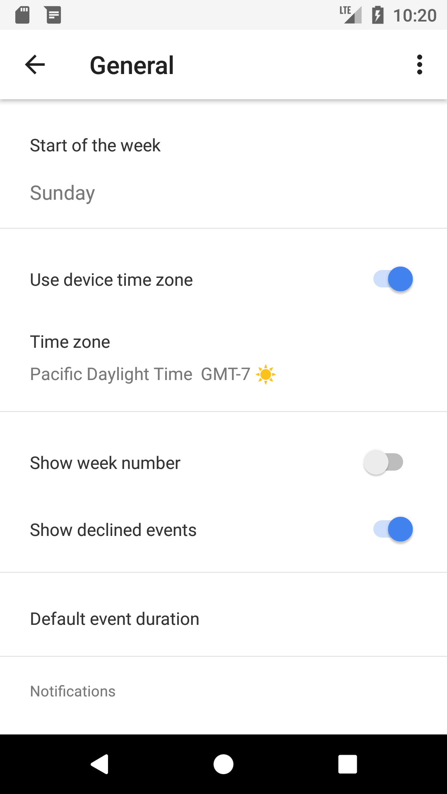
Let user configure settings
Calendar widget settings
Add app widget configuration activity to your app
Configuration activity launches when user first adds app widget to home screen

Slide 50
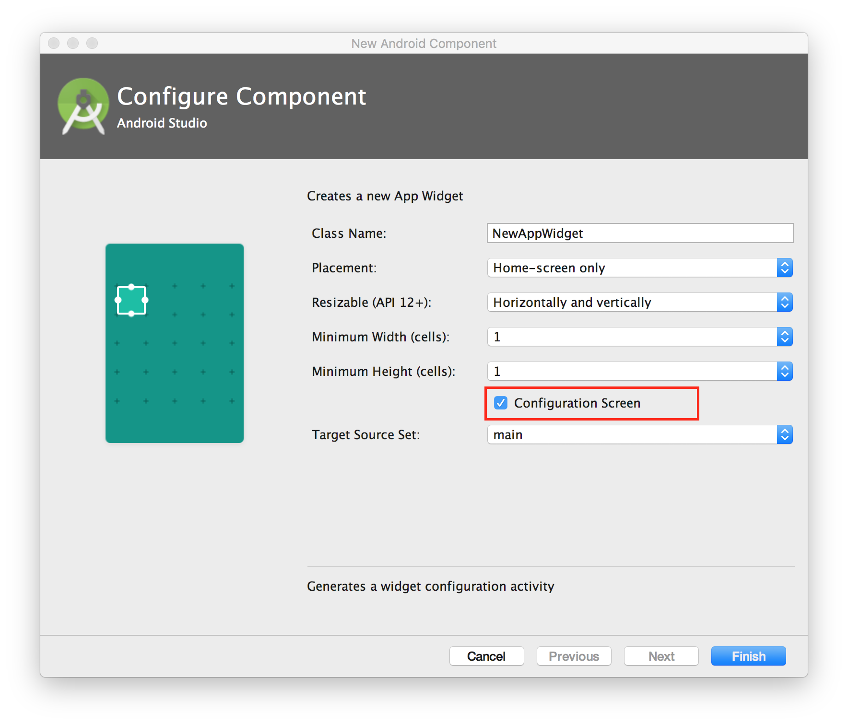
Add configuration activity to your app
When adding app widget select Configuration Screen option

Slide 51
Android manifest entry
Activity declared in Android manifest with intent filter that accepts ACTION_APPWIDGET_CONFIGURE <activity android:name=".ExampleAppWidgetConfigure">
<intent-filter>
<action
android:name=
"android.appwidget.action.APPWIDGET_CONFIGURE"/>
</intent-filter>
</activity>

Slide 52
Automatic widget-provider entry
Configuration activity is also declared in provider-info XML file using android:configure attribute
<appwidget-provider xmlns:android="http://schemas.android.com/apk/res/android"
android:configure=
"com.example.android.ExampleAppWidgetConfigure"
... >
</appwidget-provider>

Slide 53
Implement configuration activity
Get app widget ID from intent extras
Set default activity result
Get widget configuration data and store for later access
(Example: shared preferences)
Request app widget update
Create new intent to close activity

Slide 54
Get app widget ID
In onCreate() get app widget ID from intent extras with key AppWidgetManager.EXTRA_APPWIDGET_ID
Intent intent = getIntent();
Bundle extras = intent.getExtras();
if (extras != null) {
mAppWidgetId = extras.getInt(
AppWidgetManager.EXTRA_APPWIDGET_ID,
AppWidgetManager.INVALID_APPWIDGET_ID);
}

Slide 55
Set default result
In onCreate() set default activity result to RESULT_CANCELED
// This causes the widget host to cancel
// the widget placement if the user presses back button.
setResult(RESULT_CANCELED);

Slide 56
Request app widget update
Use click handler to request app widget update
AppWidgetManager appWidgetManager =
AppWidgetManager.getInstance(this);
// Create RemoteViews object with the widget layout resource
RemoteViews views = new RemoteViews(context.getPackageName(),
R.layout.example_appwidget);
// Update app widget with widget ID and new remote view:
appWidgetManager.updateAppWidget(mAppWidgetId, views);

Slide 57
Create new intent to close activity
Create new intent with widget ID as intent extra
Use key AppWidgetManager.EXTRA_APPWIDGET_ID
Set result to RESULT_OK and call finish()
Intent resultValue = new Intent();
resultValue.putExtra(AppWidgetManager.EXTRA_APPWIDGET_ID,
mAppWidgetId);
setResult(RESULT_OK, resultValue);
finish();

Slide 58
What's next?
Concept chapter: 2.1 App widgets
Practical: 2.1 Building app widgets

Slide 59
END

